Slide 1
Software Testing
Unit Testing

Slide 2
Agenda
What is the software testing?
Types of software testing.
Manual Testing.
Manual Testing simple Demo.
Automated Testing.
Unit Testing.
Edge cases.
Simple Demo with Unit Testing.
Unit Testing Cheat-Sheet.
Resources.

Slide 3
What is the software testing?

Slide 4
The process of evaluating computer code to determine whether or not it does what you expect it to do.
If you want to make sure that when you run a program, it behaves the way that it should.
When you test software, you are looking for defects.

Slide 5
Types of software testing

Slide 6
1. Manual Testing
Executing a script with different arguments to see how its behavior changed and using the interpreter to try our code before putting it in a script.

Slide 7
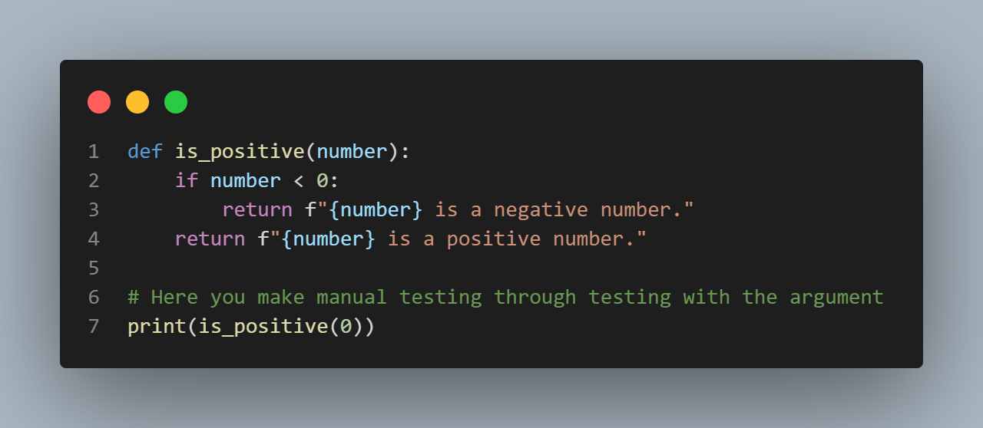
Manual Testing Demo
The code will return “0 is a positive number.”.

Slide 8
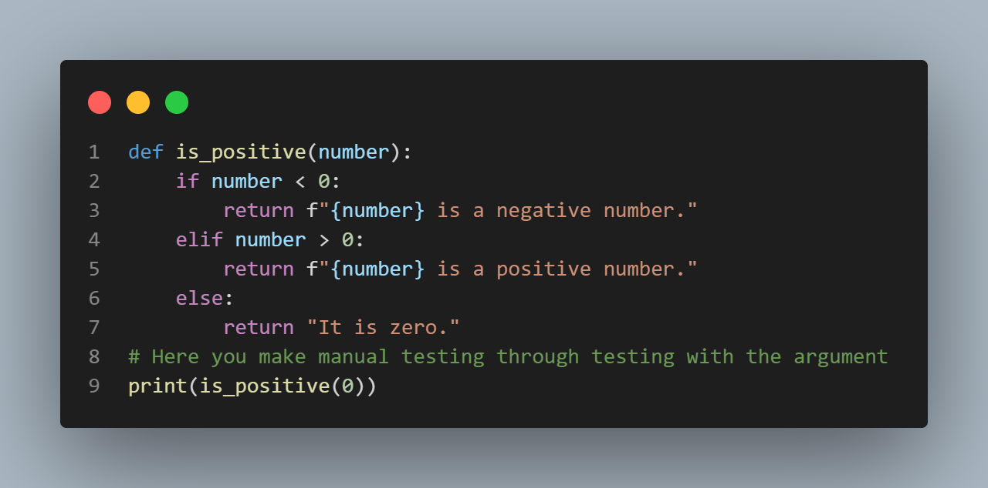
We have just added another test case.
The code will return “It is zero.”.

Slide 9
2. Automated Testing
Automated testing means we will write code to do the test.
Instead of us humans running a function over and over with different parameters and checking the results are what we expected them to be, we let the computer do this for us.
The goal of automated testing is to automate the process of checking if the returned value matches the expectations.
There are many types of automated testing but the most common type is a unit testing.

Slide 10
Unit Testing

Slide 11
Used to verify that small, isolated parts of a program are correct.
An important characteristic of a unit testing is isolation.
Unit testing is generally written alongside the code to test the behavior of individual pieces or units like functions or methods.
when testing a function or method, we want to make sure that we're focusing on checking the code in that function or method behaves correctly.
Automated tests are usually written alongside the code that we want to test. What this means in practice is creating a separate Python file with the test.
Python provides a module called unittest.

Slide 12
Edge Cases
Inputs to our code that produce unexpected results, and are found at the extreme ends of the ranges input we imagine our programs will typically work with.

Slide 13
Simple Demo with Unit Testing

Slide 14
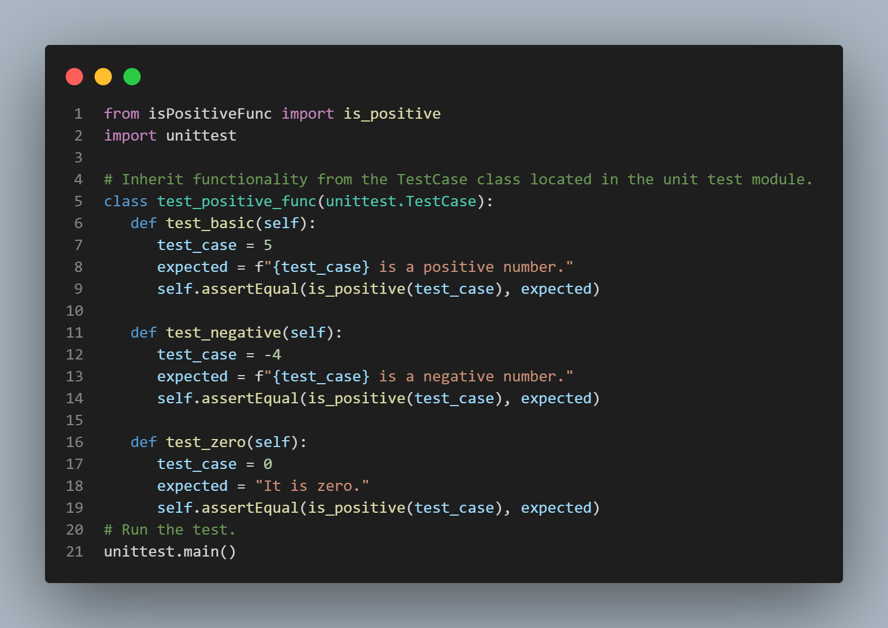

Slide 15
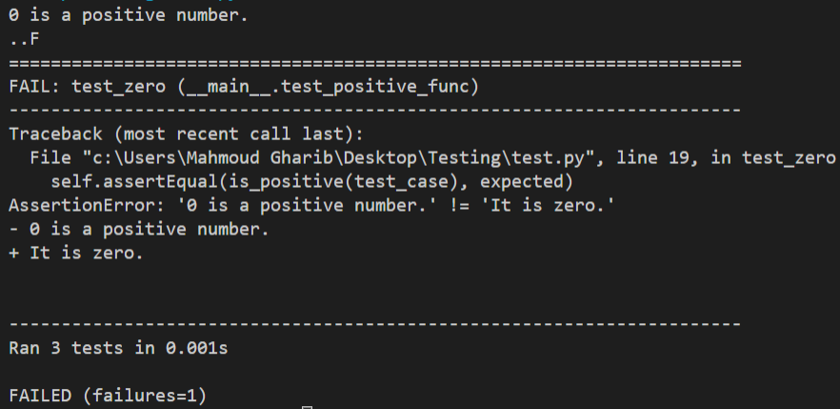
When we tested the code before modifying it, This error appeared for us.

Slide 16
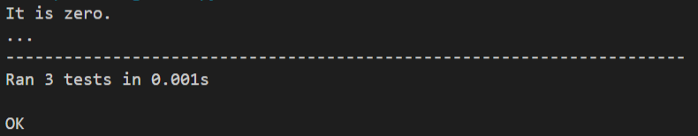
But when we tested the code after modifying it, the code ran correctly.

Slide 17
Unit Testing Cheat-Sheet

Slide 18
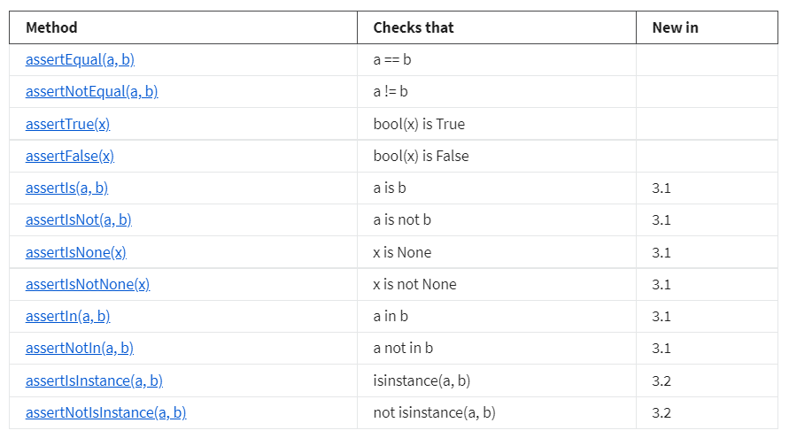

Slide 19
Resources

Slide 20
https://docs.python.org/3/library/unittest.html#basic-example
https://docs.python.org/3/library/unittest.html#command-line-interface
https://docs.python.org/3/library/unittest.html#organizing-test-code
https://docs.python.org/3/library/unittest.html#unittest.TestCase.assertRaises

